Slide 1
Williamsburg Middle School
Gifted Services
Overview

Slide 2
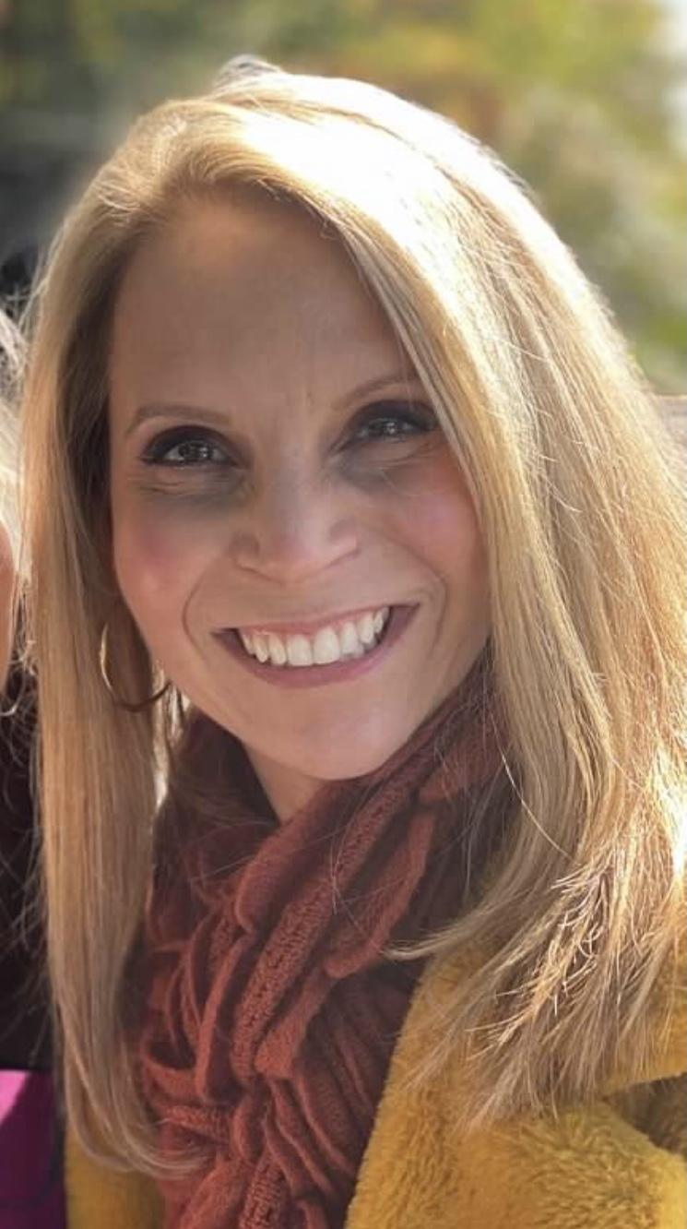
Hello!
I am Kristie Board
Educator at APS for 9 years (RTG, Classroom teacher, and and Instructional Lead Teacher)
Educator in Virginia for 19 years
Prior APS Parent
Undergraduate and graduate degrees from JMU
Gifted Education certification from UVA
You can find me at @kristie_board

Slide 3
Gifted Services at Williamsburg
How are gifted services provided?
Identified students are grouped in clusters with other identified peers within the content area classrooms.
Classroom teachers provide differentiation for gifted learners within the classroom setting.
Teachers with gifted clusters have training in gifted education.

Slide 4
Gifted Services at Williamsburg
My job, as the RTG is to:
  support and coach classroom teachers as they increase rigor and infuse critical and creative thinking for all learners.
  collaborate with grade-level teams to plan and/or implement advanced content/ differentiated instruction.
  maintain the gifted services website: includes resources and monthly newsletter for parents
  support you and your child

Slide 5
Screening, Referral, & Identification Process
As the RTG, I also manage the screening, referral and identification process.
Specifics about the testing process for this year will be shared during the Gifted Services Parent Information Session coming this fall.
The gifted identification process typically begins in the Spring, however the collection of documentation and learner observations takes place all year.
Referrals may be submitted by parents, teachers, students, and other staff members. For more information, visit the Identification page on our website.

Slide 6

I am here to support you and your child!
Email: kristie.board@apsva.us
Website: https://williamsburg.apsva.us/gifted-services-williamsburg/
Twitter: @kristie_board
Place your screenshot here

Slide 7
APS Gifted Resources
Parent Academy Site: Overview of Gifted Services video
https://www.apsva.us/gifted-services/
Twitter: @APSGifted

